Slide 1
Hvad tænker I om begrebet QoS?

Slide 2
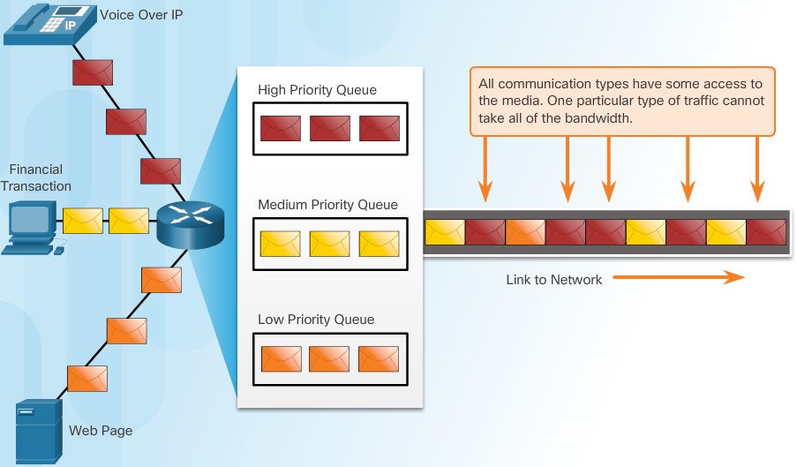
Network Transmission Quality
Prioritering af trafik
  Når pakker skal ligge i kø skabes delay, fordi nye pakker ikke kan videresendes inden de tidligere pakker er behandlet.
  Hvis antallet af pakker der venter i kø bliver ved med at forøges, kan enheden (switch/router) ikke blive ved med at have plads til at opbevare pakerne og pakkerne droppes!

Slide 3
Network Transmission Quality
Hvorfor opstår der kø? (hvis der gør!)
Bandwidth, Congestion, Delay, and Jitter
  Delay is the time it takes for a packet to travel from the source to the destination.
  Jitter is the variation in the delay of received packets.
Packet Loss
  When congestion occurs, network devices such as routers and switches can drop packets.
  Packet loss is a very common cause of voice quality problems on an IP network.
  In a properly designed network, packet loss should be near zero.
  Network engineers use QoS mechanisms to classify packets for zero packet loss.

Slide 4
Traffic Characteristics
  Forskellige krav til forskellige typer trafik:
Voice
  Voice is very sensitive to delays and dropped packets; there is no reason to re-transmit voice if packets are lost. Voice can tolerate only a certain amount of latency, jitter, and loss without noticeable effects.
  Voice packets must receive a higher priority than other types of traffic.
Video
  Video can tolerate a certain (higher than Voice) amount of latency, jitter, and loss without any noticeable affects.
Data
  Data applications that have no tolerance for data loss, such as email and web pages, use TCP to ensure that, if packets are lost in transit, they will be resent.
  Data traffic is relatively insensitive to drops and delays compared to voice and video.

Slide 5
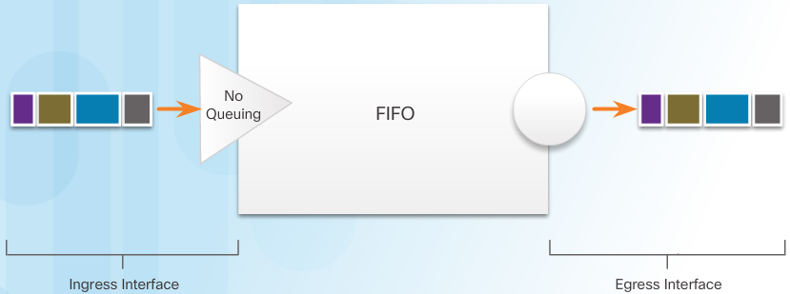
Queueing Algorithms
First In First Out (FIFO) = ingen prioritet.
  FIFO has no concept of priority or classes of traffic and consequently, makes no decision about packet priority.
  FIFO, which is the fastest method of queuing, is effective for large links that have little delay and minimal congestion.

Slide 6
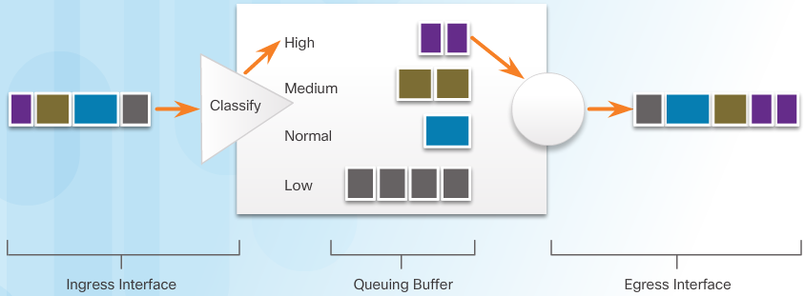
Queueing Algorithms
Weighted Fair Queuing (WFQ) = trafik inddeles i foruddefinerede klasser.
(hvis vi selv vil definere klasserne, kaldes det Class-Based Weighted Fair Queuing, og det ser vi på næste side)
  An automated scheduling method that provides fair bandwidth allocation to all network traffic.
  Applies priority (= weights), to identified traffic and classifies it into conversations or flows. [Klasserne er foruddefinerede, som på tegningen!]
  !!!!! WFQ is not supported with tunneling and encryption because these features modify the packet content information required.

Slide 7
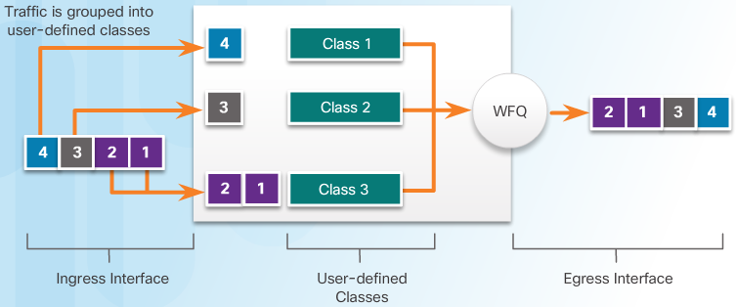
Queueing Algorithms
Class-Based Weighted Fair Queuing (CBWFQ)
  Extends the standard WFQ functionality to provide support for user-defined traffic classes.
  To characterize a class, you assign it bandwidth, weight, and maximum packet limit.
  You also specify the queue limit for that class, which is the maximum number of packets allowed to accumulate in the queue for the class.
Notes:
Som WFQ som vi så på for et øjeblik siden – men nu er det os selv der definerer hvilke klasser der skal være og hvilken trafik der skal i hvilke klasse

Slide 8
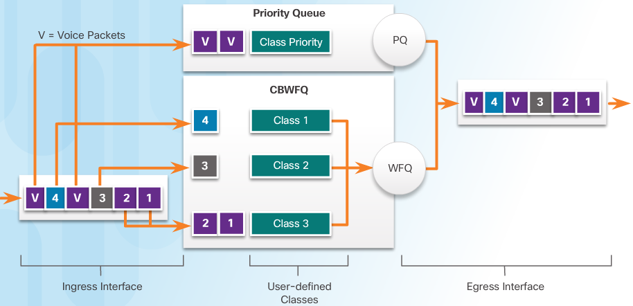
Queueing Algorithms
Low Latency Queuing (LLQ) = noget får absolut førsteret ☺
LLQ provides strict priority (= har altid førsteret, inden almindelig CBWFQ træder i kraft for resten af trafik typerne).
  LLQ allows delay-sensitive data such as voice to be sent first.
Notes:
Lidt nemre modern end “bare” CBWFQ = Class-Based Weighted Fair Queuing

Slide 9
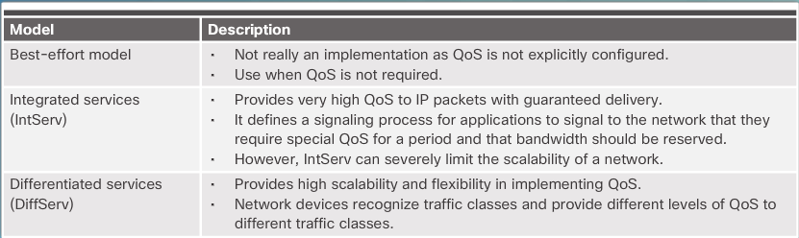
QoS Modeller
  Best-effort = ingen QoS implementeret! (FIFO)
  IntServ = Kaldes “integrated” sevices, fordi enhederne som behandler pakkerne fra afsender til modtager, sender besked i forvejen at der om lidt kommer noget trafik som skal have en speciel behandling. Ikke alle enheder kan genkende denne signaleringsmetode. Duer ikke i store komplekse netværk.
  DiffServ = Datapakkerne er opdelt i klasser, som alle enheder ved hvordan skal behandles. Virker også på tværs af store netværk (f.eks. Internettet). Altså de klassificerings metoder vi lige har talt om ☺

Slide 10
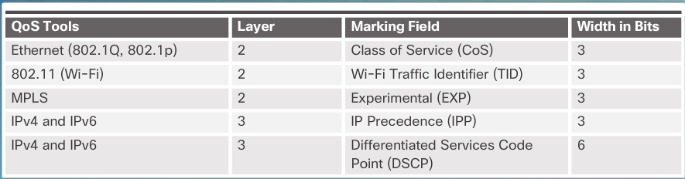
QoS Implementation Techniques
Classification and Marking
  Before a packet can have a QoS policy applied to it, the packet has to be classified.
  I praksis betyder det at der udfyldes et felt i L3 og/eller L2 headeren ☺
  Se i nedenståede skema hvornår man markerer på hhv. Layer 2 og 3, hvad markeringsfeltet hedder og hvor meget det fylder.

Slide 11
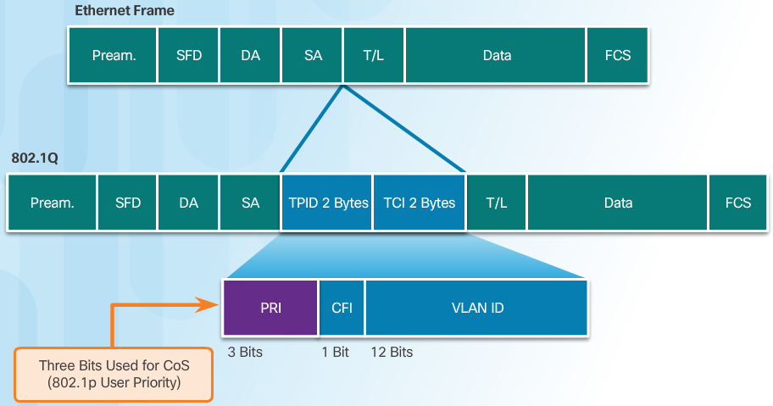
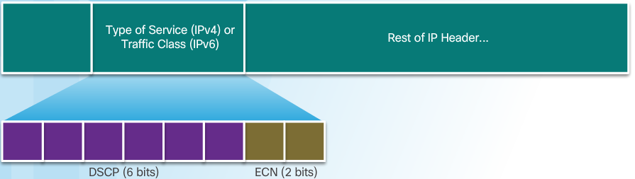
QoS Implementation Techniques
Marking at Layer 2
Marking at Layer 3
Notes:
DSCP = Differentiated Services Code Point bruges både i offentlige og private netværk = QoS

Slide 12
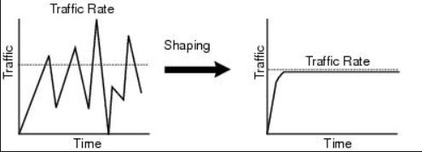
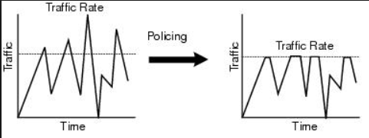
QoS Implementation Techniques
Trust Boundaries (= der hvor pakkerne bliver klassificeret)
  Traffic should be classified and marked as close to its source as technically and administratively feasible.
Shaping and Policing
  Traffic shaping opbevarer udgående pakker i en kø og fordeler trafikken til senere transmission (hen over længere tid).
  Policing kontrollerer indgående trafik på et interface.
  Hvis trafikmængden overstiger den konfigurerede maximum rate, klippes den del af trafikken som overstiger max, og trafikken droppes (eller “ommærkes”) I stedet for at videresendes.
>>>Video: MicroNugget_ Using Quality of Service (QoS) Tools<<<< (ca. 5 min.) ..\..\MicroNugget_ Using Quality of Service (QoS) Tools.mp4

Slide 13


